Slide 1


Marathwada Mitra mandal’s
COLLEGE OF ENGINEERING
Karvenagar, Pune
An Autonomous Institute
Presentation
On
Food Delivery Service App
Notes:
‹#›

Slide 2
Group Information
Sr.No | Prn No | Name of students
1 | B24IT1056 | Atharva Pardeshi
2 | B24IT1001 | Harsh Kurhe
3 | B24IT1016 | Nishant Ambadkar
4 | B24IT1005 | Karan Bhapkar

Slide 3
Introduction
Definition: A food delivery service app is a digital platform that allows users to order food from local restaurants and have it delivered to their doorstep.
.
Purpose: It simplifies the process of ordering food, offering convenience, variety, and speed for both customers and restaurants.
Users: The app typically serves three types of users — customers, delivery personnel, and restaurant partners.
Key Features:
Restaurant browsing with menus and photos
Real-time order tracking
Secure payment gateways
Ratings and reviews
Push notifications for offers and updates

Slide 4
Objectives:
Connect Customers and Restaurants: Act as a digital bridge between restaurants and potential customers.
Ensure Fast and Timely Delivery: Optimize routes and assign delivery personnel to ensure food reaches customers hot and fresh.
Offer Multiple Payment Options: Provide secure and flexible payment methods including cards, UPI, wallets, and cash on delivery.
Enhance User Experience: Deliver a seamless, user-friendly interface with personalized recommendations and easy navigation.
Increase Restaurant Reach and Sales: Help restaurants attract more customers beyond their local walk-in base.
Track Orders in Real-Time: Allow customers and delivery partners to monitor the live status of each order.
Collect Feedback: Enable users to rate and review restaurants and delivery services for quality improvement.

Slide 5
Feature (Module Description)
User Module – Sign up, browse restaurants, order food, track orders, and give feedback.
Restaurant Module – Manage menu, receive orders, update status, and view sales reports.
Delivery Module – Accept deliveries, track routes, update delivery status, and view earnings.
Admin Module – Control users, restaurants, deliveries, view analytics, and manage promotions.
Payment Module – Secure online payments with multiple options and invoice generation.
Notification Module – Send real-time updates and promotional alerts to users.

Slide 6
Functional and non-functional requirement
Functional Requirements :
User registration and login
Browse restaurants and place food orders
Online payment and invoice generation
Real-time order tracking
Non-Functional Requirements :
High performance and fast response time
Secure data handling and transactions
User-friendly interface
Cross-platform compatibility (Android, iOS)

Slide 7
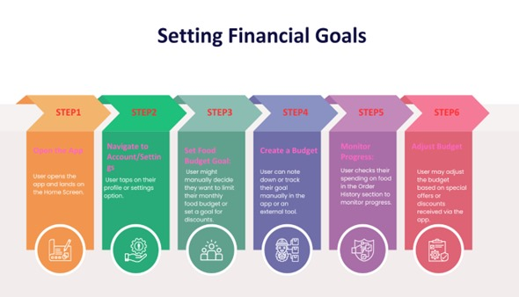
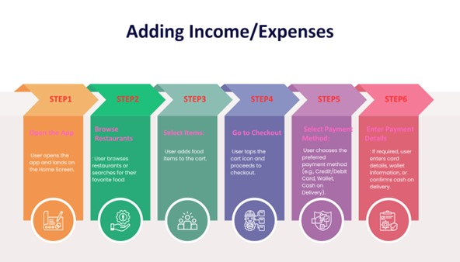
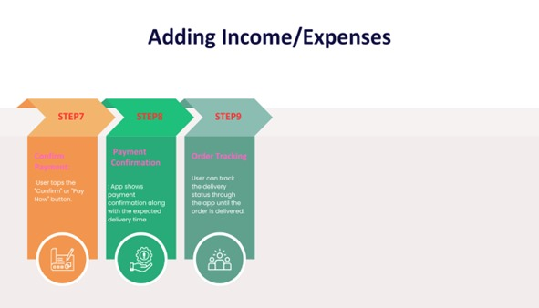
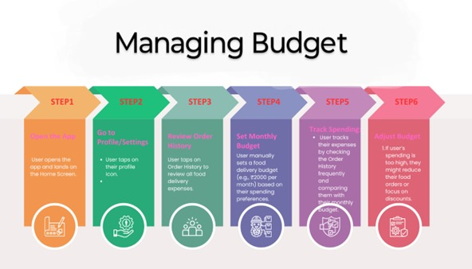
Task Flow

Slide 8
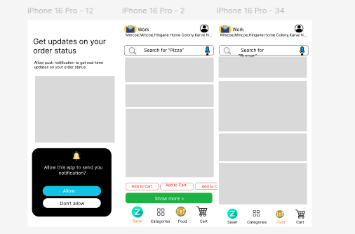
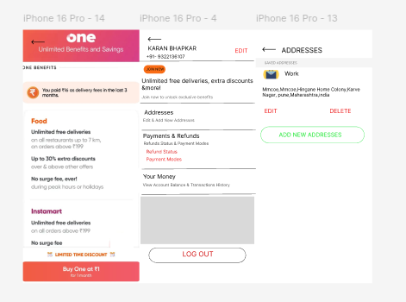
Low-Fidelity Wireframes

Slide 9
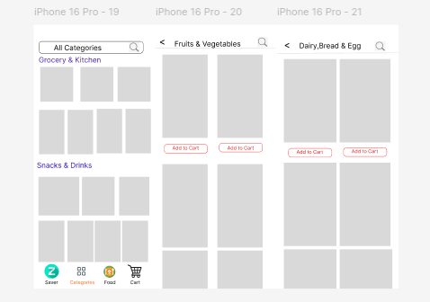
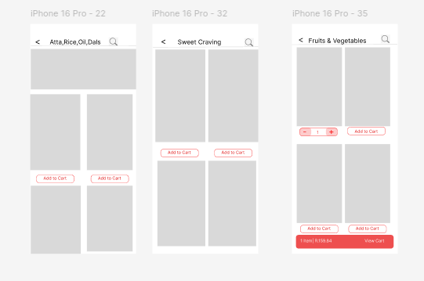

Slide 10
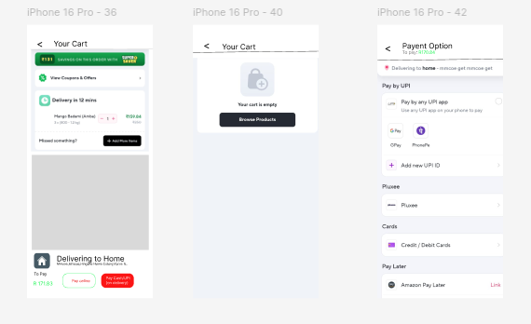
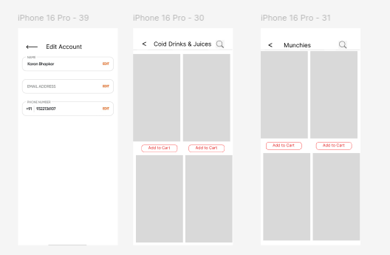

Slide 11
Link of Prototype
High Fidelity: https://www.figma.com/design/9xmW0UBNaThOFyRBaaQwI8/Untitled?node-id=134-4&t=m2fRZynTlyRkCTiv-1
Low Fidelity: https://www.figma.com/design/pN2lLI76ZD3fnxWZcj4NYi/Untitled?node-id=0-1&t=Y1NA4NfQYTyochFi-1
Video Link: https://youtube.com/shorts/-zgZBHTlMp4?si=OY0Idkka7qSvJgEs
Github: https://github.com/Atharva992/food-delivery-app

